Slide 1


Desenvolvimento rápido de bots empresariais com Microsoft Bot Framework

Slide 2
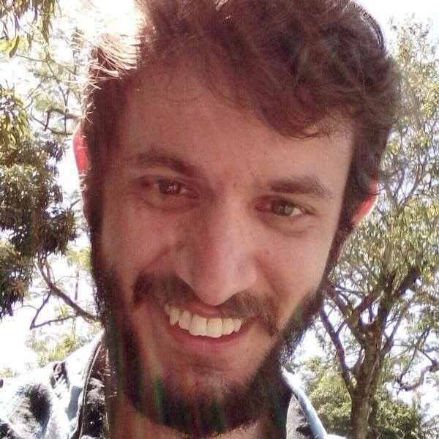
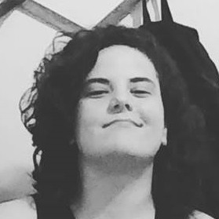
Quem somos
Arie Rodrigues
Engenheiro de Software
Ariel Medeiros
Engenheira de Software

Slide 3
Agenda
01
02
03
Sobre chatbots
O que é
Preocupações
Bot Framework
O poder do bot framework
Inteligência do bot
Processos técnicos
Portal azure
Plataforma do LUIS
Implementação em C#

Slide 4


SOBRE CHATBOTS
O QUE É?
Uma interface para humanos com o propósito de atender necessidades de comunicação através de textos ou serviços automatizados
Notes:
Microsoft and Accenture formed Avanade in 2000, and ever since we’ve built an important alliance. (Today, Accenture majority owns Avanade).
We call this relationship the Power of Three because we can bring together the best of each of us: expertise, solutions and resources—to bring to life our clients’ goals.
Avanade has the unique ability to pull together the necessary resources from our partners to ensure that our clients successfully navigate the digital journey.
We have:
Global reach
A solid 15 year legacy
Deep and wide digital expertise
Powerful partnerships
Passionate people
A culture focused on innovation

Slide 5
SOBRE CHATBOTS
PREOCUPAÇÕES
Definição de escopo
Persona
Expectativas elevadas
©2017 Avanade Inc. All Rights Reserved.
©2017 Avanade Inc. All Rights Reserved.
Notes:
Microsoft and Accenture formed Avanade in 2000, and ever since we’ve built an important alliance. (Today, Accenture majority owns Avanade).
We call this relationship the Power of Three because we can bring together the best of each of us: expertise, solutions and resources—to bring to life our clients’ goals.
Avanade has the unique ability to pull together the necessary resources from our partners to ensure that our clients successfully navigate the digital journey.
We have:
Global reach
A solid 15 year legacy
Deep and wide digital expertise
Powerful partnerships
Passionate people
A culture focused on innovation

Slide 6
BOT FRAMEWORK
O PODER DO BOT FRAMEWORK
Canais de comunicação
Conjunto de recursos
Integrações
©2017 Avanade Inc. All Rights Reserved.
©2017 Avanade Inc. All Rights Reserved.
Notes:
Microsoft and Accenture formed Avanade in 2000, and ever since we’ve built an important alliance. (Today, Accenture majority owns Avanade).
We call this relationship the Power of Three because we can bring together the best of each of us: expertise, solutions and resources—to bring to life our clients’ goals.
Avanade has the unique ability to pull together the necessary resources from our partners to ensure that our clients successfully navigate the digital journey.
We have:
Global reach
A solid 15 year legacy
Deep and wide digital expertise
Powerful partnerships
Passionate people
A culture focused on innovation

Slide 7
BOT FRAMEWORK
A INTELIGÊNCIA DO BOT
NLPs
LUIS
  BingSpellChecker
©2017 Avanade Inc. All Rights Reserved.
©2017 Avanade Inc. All Rights Reserved.
Notes:
Microsoft and Accenture formed Avanade in 2000, and ever since we’ve built an important alliance. (Today, Accenture majority owns Avanade).
We call this relationship the Power of Three because we can bring together the best of each of us: expertise, solutions and resources—to bring to life our clients’ goals.
Avanade has the unique ability to pull together the necessary resources from our partners to ensure that our clients successfully navigate the digital journey.
We have:
Global reach
A solid 15 year legacy
Deep and wide digital expertise
Powerful partnerships
Passionate people
A culture focused on innovation

Slide 8
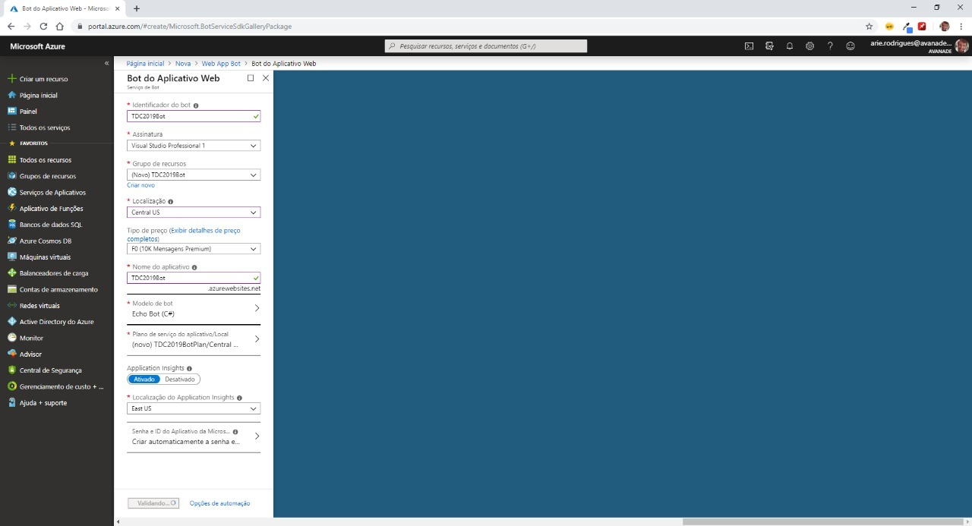
PROCESSOS TÉCNICOS
©2017 Avanade Inc. All Rights Reserved.
©2017 Avanade Inc. All Rights Reserved.
Notes:
Microsoft and Accenture formed Avanade in 2000, and ever since we’ve built an important alliance. (Today, Accenture majority owns Avanade).
We call this relationship the Power of Three because we can bring together the best of each of us: expertise, solutions and resources—to bring to life our clients’ goals.
Avanade has the unique ability to pull together the necessary resources from our partners to ensure that our clients successfully navigate the digital journey.
We have:
Global reach
A solid 15 year legacy
Deep and wide digital expertise
Powerful partnerships
Passionate people
A culture focused on innovation

Slide 9
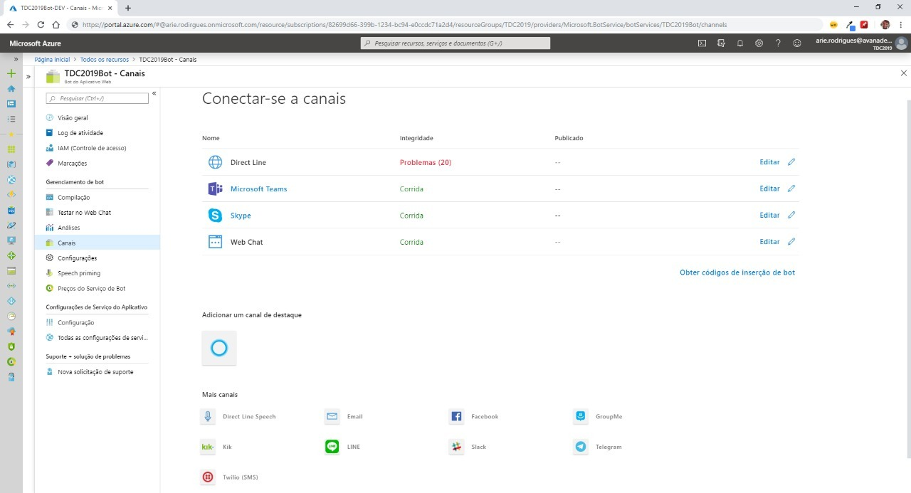
PROCESSOS TÉCNICOS
©2017 Avanade Inc. All Rights Reserved.
©2017 Avanade Inc. All Rights Reserved.
Notes:
Microsoft and Accenture formed Avanade in 2000, and ever since we’ve built an important alliance. (Today, Accenture majority owns Avanade).
We call this relationship the Power of Three because we can bring together the best of each of us: expertise, solutions and resources—to bring to life our clients’ goals.
Avanade has the unique ability to pull together the necessary resources from our partners to ensure that our clients successfully navigate the digital journey.
We have:
Global reach
A solid 15 year legacy
Deep and wide digital expertise
Powerful partnerships
Passionate people
A culture focused on innovation

Slide 10
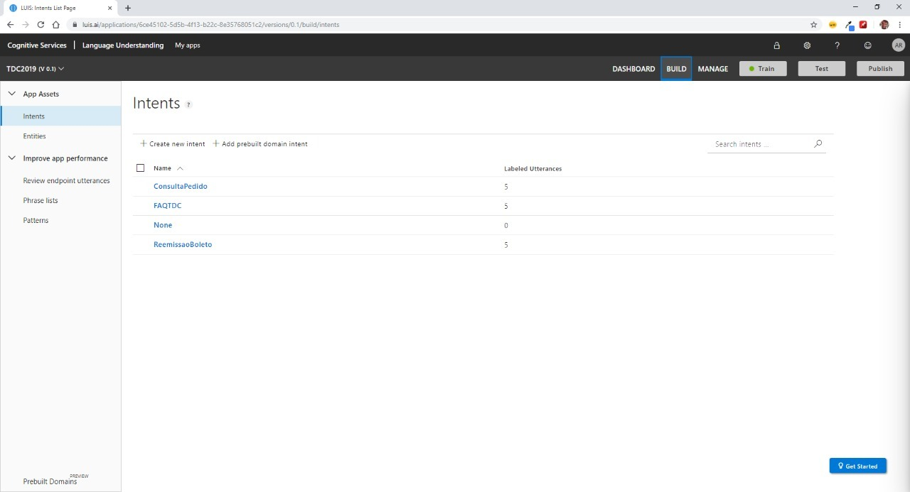
PROCESSOS TÉCNICOS
©2017 Avanade Inc. All Rights Reserved.
©2017 Avanade Inc. All Rights Reserved.
Notes:
Microsoft and Accenture formed Avanade in 2000, and ever since we’ve built an important alliance. (Today, Accenture majority owns Avanade).
We call this relationship the Power of Three because we can bring together the best of each of us: expertise, solutions and resources—to bring to life our clients’ goals.
Avanade has the unique ability to pull together the necessary resources from our partners to ensure that our clients successfully navigate the digital journey.
We have:
Global reach
A solid 15 year legacy
Deep and wide digital expertise
Powerful partnerships
Passionate people
A culture focused on innovation

Slide 11
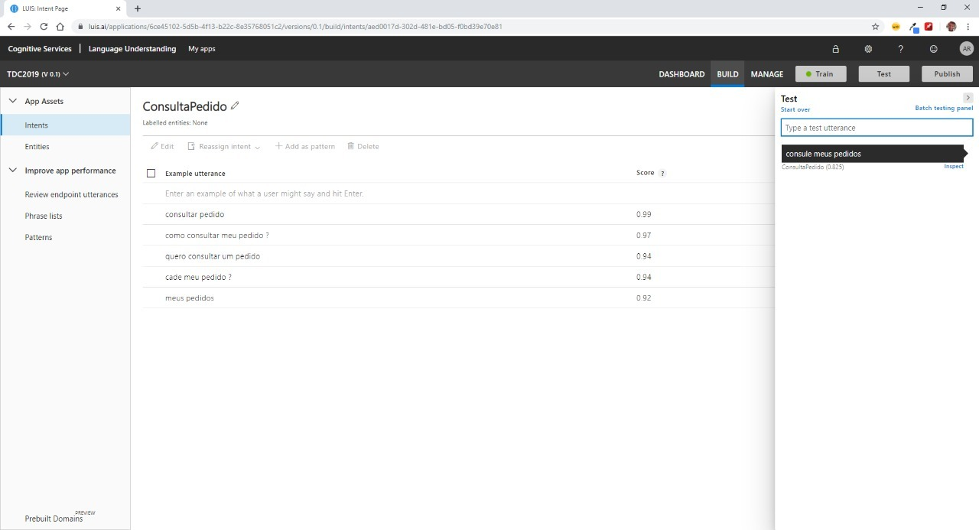
PROCESSOS TÉCNICOS
©2017 Avanade Inc. All Rights Reserved.
©2017 Avanade Inc. All Rights Reserved.
Notes:
Microsoft and Accenture formed Avanade in 2000, and ever since we’ve built an important alliance. (Today, Accenture majority owns Avanade).
We call this relationship the Power of Three because we can bring together the best of each of us: expertise, solutions and resources—to bring to life our clients’ goals.
Avanade has the unique ability to pull together the necessary resources from our partners to ensure that our clients successfully navigate the digital journey.
We have:
Global reach
A solid 15 year legacy
Deep and wide digital expertise
Powerful partnerships
Passionate people
A culture focused on innovation

Slide 12
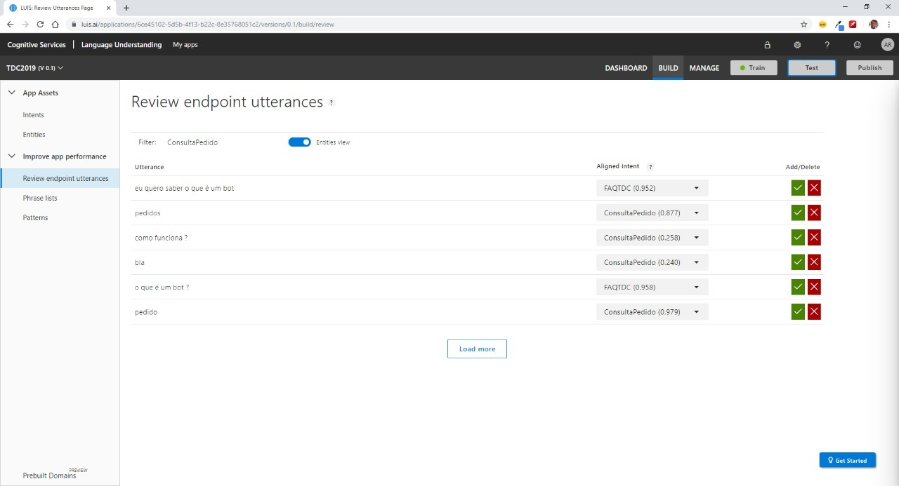
PROCESSOS TÉCNICOS
©2017 Avanade Inc. All Rights Reserved.
©2017 Avanade Inc. All Rights Reserved.
Notes:
Microsoft and Accenture formed Avanade in 2000, and ever since we’ve built an important alliance. (Today, Accenture majority owns Avanade).
We call this relationship the Power of Three because we can bring together the best of each of us: expertise, solutions and resources—to bring to life our clients’ goals.
Avanade has the unique ability to pull together the necessary resources from our partners to ensure that our clients successfully navigate the digital journey.
We have:
Global reach
A solid 15 year legacy
Deep and wide digital expertise
Powerful partnerships
Passionate people
A culture focused on innovation

Slide 13
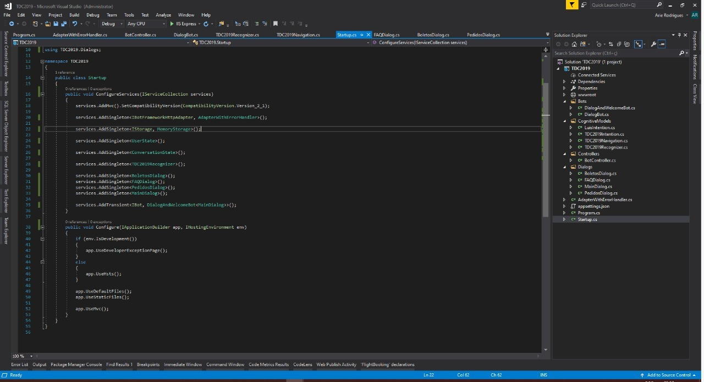
PROCESSOS TÉCNICOS
©2017 Avanade Inc. All Rights Reserved.
©2017 Avanade Inc. All Rights Reserved.
Notes:
Microsoft and Accenture formed Avanade in 2000, and ever since we’ve built an important alliance. (Today, Accenture majority owns Avanade).
We call this relationship the Power of Three because we can bring together the best of each of us: expertise, solutions and resources—to bring to life our clients’ goals.
Avanade has the unique ability to pull together the necessary resources from our partners to ensure that our clients successfully navigate the digital journey.
We have:
Global reach
A solid 15 year legacy
Deep and wide digital expertise
Powerful partnerships
Passionate people
A culture focused on innovation

Slide 14
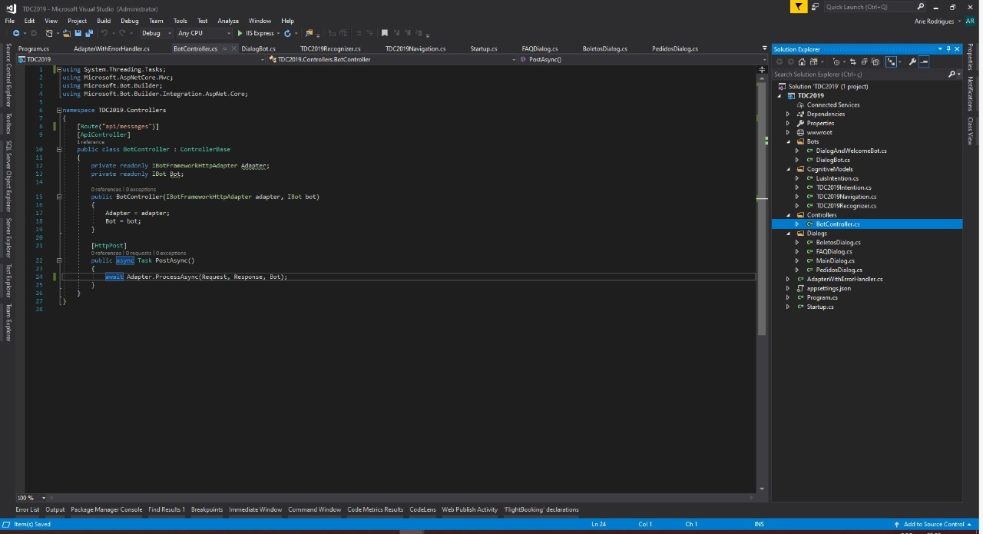
PROCESSOS TÉCNICOS
©2017 Avanade Inc. All Rights Reserved.
©2017 Avanade Inc. All Rights Reserved.
Notes:
Microsoft and Accenture formed Avanade in 2000, and ever since we’ve built an important alliance. (Today, Accenture majority owns Avanade).
We call this relationship the Power of Three because we can bring together the best of each of us: expertise, solutions and resources—to bring to life our clients’ goals.
Avanade has the unique ability to pull together the necessary resources from our partners to ensure that our clients successfully navigate the digital journey.
We have:
Global reach
A solid 15 year legacy
Deep and wide digital expertise
Powerful partnerships
Passionate people
A culture focused on innovation

Slide 15
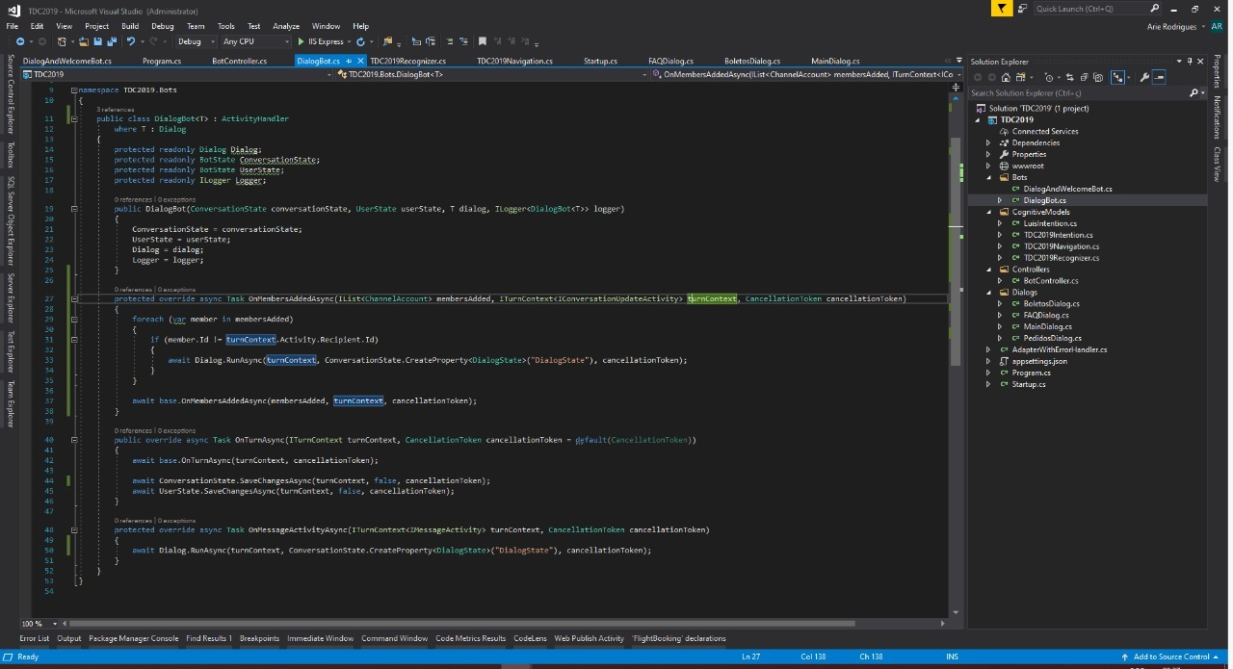
PROCESSOS TÉCNICOS
©2017 Avanade Inc. All Rights Reserved.
©2017 Avanade Inc. All Rights Reserved.
Notes:
Microsoft and Accenture formed Avanade in 2000, and ever since we’ve built an important alliance. (Today, Accenture majority owns Avanade).
We call this relationship the Power of Three because we can bring together the best of each of us: expertise, solutions and resources—to bring to life our clients’ goals.
Avanade has the unique ability to pull together the necessary resources from our partners to ensure that our clients successfully navigate the digital journey.
We have:
Global reach
A solid 15 year legacy
Deep and wide digital expertise
Powerful partnerships
Passionate people
A culture focused on innovation

Slide 16
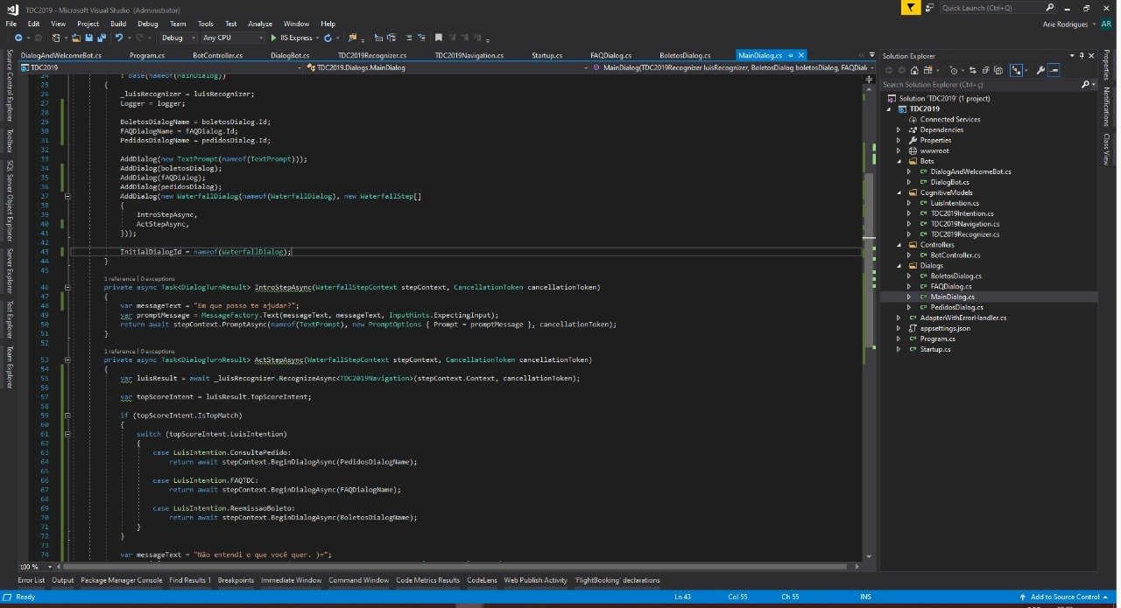
PROCESSOS TÉCNICOS
©2017 Avanade Inc. All Rights Reserved.
©2017 Avanade Inc. All Rights Reserved.
Notes:
Microsoft and Accenture formed Avanade in 2000, and ever since we’ve built an important alliance. (Today, Accenture majority owns Avanade).
We call this relationship the Power of Three because we can bring together the best of each of us: expertise, solutions and resources—to bring to life our clients’ goals.
Avanade has the unique ability to pull together the necessary resources from our partners to ensure that our clients successfully navigate the digital journey.
We have:
Global reach
A solid 15 year legacy
Deep and wide digital expertise
Powerful partnerships
Passionate people
A culture focused on innovation

Slide 17
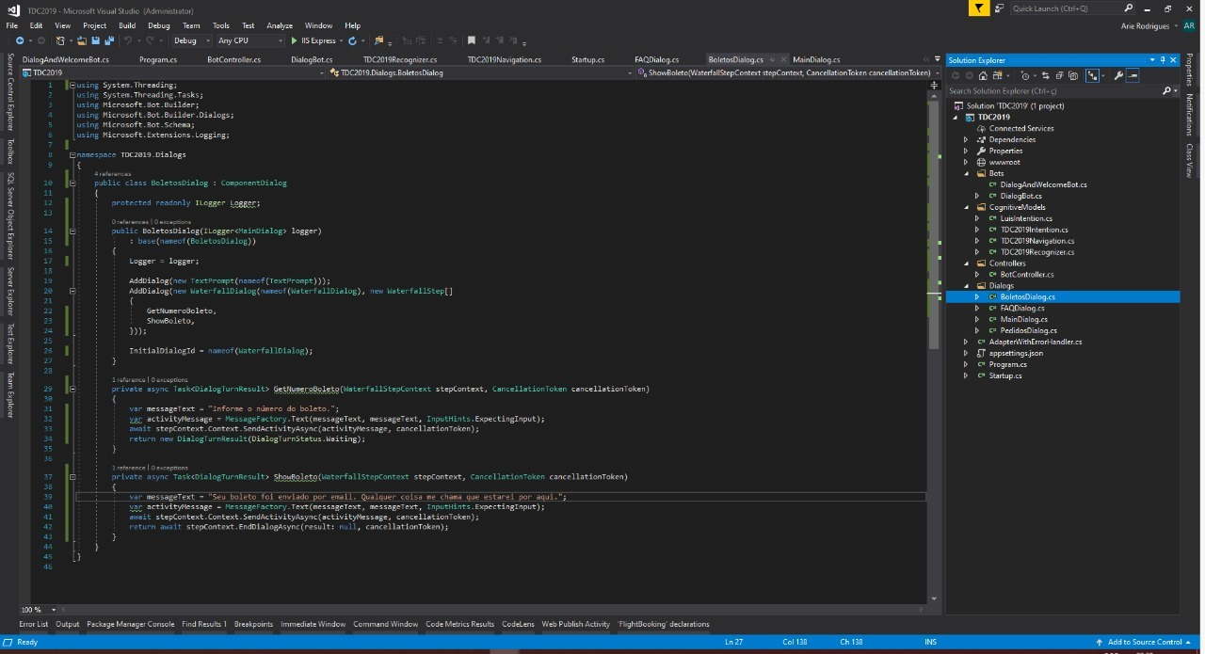
PROCESSOS TÉCNICOS
©2017 Avanade Inc. All Rights Reserved.
©2017 Avanade Inc. All Rights Reserved.
Notes:
Microsoft and Accenture formed Avanade in 2000, and ever since we’ve built an important alliance. (Today, Accenture majority owns Avanade).
We call this relationship the Power of Three because we can bring together the best of each of us: expertise, solutions and resources—to bring to life our clients’ goals.
Avanade has the unique ability to pull together the necessary resources from our partners to ensure that our clients successfully navigate the digital journey.
We have:
Global reach
A solid 15 year legacy
Deep and wide digital expertise
Powerful partnerships
Passionate people
A culture focused on innovation

Slide 18
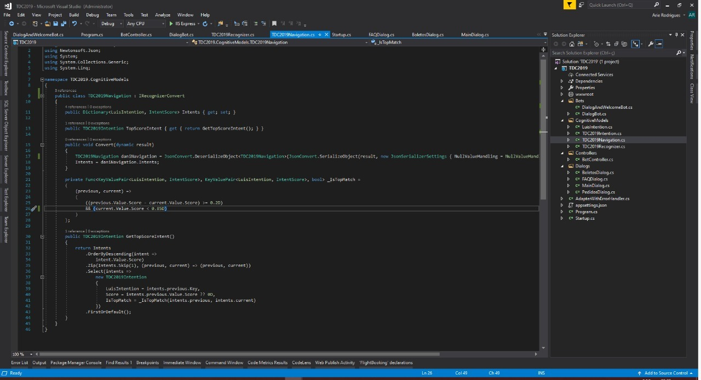
PROCESSOS TÉCNICOS
©2017 Avanade Inc. All Rights Reserved.
©2017 Avanade Inc. All Rights Reserved.
Notes:
Microsoft and Accenture formed Avanade in 2000, and ever since we’ve built an important alliance. (Today, Accenture majority owns Avanade).
We call this relationship the Power of Three because we can bring together the best of each of us: expertise, solutions and resources—to bring to life our clients’ goals.
Avanade has the unique ability to pull together the necessary resources from our partners to ensure that our clients successfully navigate the digital journey.
We have:
Global reach
A solid 15 year legacy
Deep and wide digital expertise
Powerful partnerships
Passionate people
A culture focused on innovation

Slide 19
OBRIGADO!
Entre em contato com a gente pelos emails:
arie.rodrigues@avanade.com
a.a.medeiros.cintra@avanade.com

